Slide 1
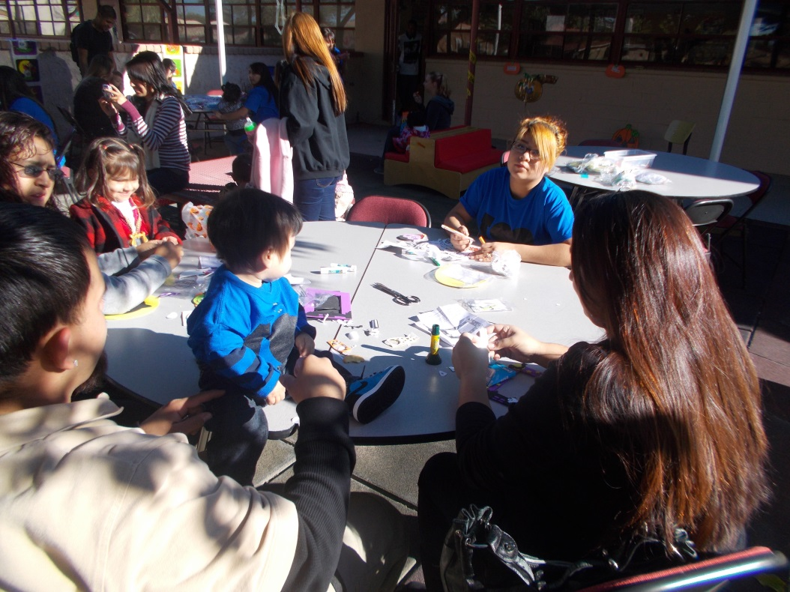
Implementing and Putting
Student Notebooks into Action!

Slide 2
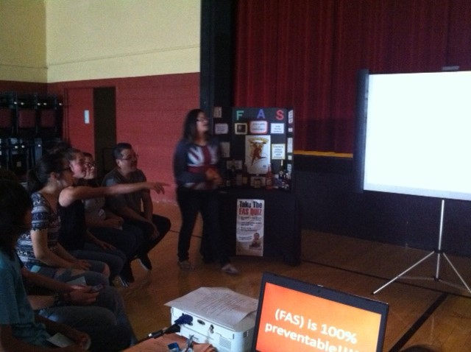
Student Buy IN
Students who are engaged are involved but not all students who are involved are engaged. The most critical difference between students who are engaged and those who are not is the way they relate to the situation or task at hand.
(Engaging Students by Phillip Schlechty)
5 Ways a Student might respond to a learning task:
1. Authentic engagement
2. Ritual engagement
3. Passive compliance
4. Retreatism
5. Rebellion

Slide 3
Healthy & Safe Environment for Children 6.2 Employ strategies designed to meet children’s hygiene needs 6.3 Employ safety practices to minimize hazards 6.4 Demonstrate basic first aids skills 6.5 Care for children during illness 6.6 Evaluate child care services *Project: First Aid Kits & CPR training Self Formation Assess personal development Analyze factors contributing to the development of self within the family Analyze self esteem and its effects Develop a plan to achieve personal goalsManage stressful situations Human Anatomy Economic Independence 8.2 Identify traditional and non traditional occupational options 8.3 Assess career interest and skills 8.4 Develop a career plan Special Event: NMSU /DACC field trip- Career Academy UNITS done every semester: Individualized Units Pregnancy,Wellness,& PrenatalCare2.1,2.2,2.3,2.5 Postpartum & Neonatal Care3.1,3.2,3.3 STD’s2.4, 7.11 BirthControl/Sexual decisions 3.4, 7.12,7.13 Projects done once/yr Special Events: Fall & Spring Carnival Fetal Alcohol Syndrome Training with Jerome *Project: Teen Panel Presentations: Field trip to Middle school to present | Parenting 4.1 Analyze attitudes and expectations of parenthood 4.2 Identify parenting roles, rights, and responsibilities 4.3 Identify strategies for meeting the challenges of parenting children with special needs 4.4 Analyze legal issues related to parenthood *Project: memory boxes, Scrapbooks Healthy & Safe Environment for Children 6.7 Discipline techniques 6.8 Develop strategies for establishing cooperative parenting environments Child Development 5.7 Respond to specific parenting challenges 5.8 Employ communication skills in guiding young children Relationships & Social Support Systems 7.5 Analyze factors related to child abuse and neglect 7.6 Assess dynamics of domestic abuse *Project: Quilt | Relationships & Social Support Systems (Use a Novel) 7.1 Maintain friendships 7.2 Identify characteristics of healthy partner relationships 7.3 Analyze factors related to marriage 7.4 Analyze factors affecting families 7.7 Assess dynamics of sexual abuse 7.8 Manage conflict 7.9 Investigate family legal issues 7.10 Employ strategies designed to meet the basic needs of a teen parenting family *Project: Community Project- Casa de Pellegrino’s,La Casa, La Pinon Economic Independence 8.1 Assess School to work needs 8.5 Manage family income and expenses 8.6 Assess savings, checking, credit options 8.7 Define equitable roles, rights and responsibility in the school and workplace Employability 9.1Developa job search plan 9.2 Apply communication skills employment search 9.3 Demonstrate interview skills 9.4 Employ strategies designed to meet responsibilities a working parents 9.5 Develop time mgmt plan 9.6 Identify behaviors required to be successful in school and work *Project: Career Portfolio-personal stick drives with resume, awards, etc. | Child Development 5.1 Set goals to meet child’s dependency needs 5.2 Recognize parental roles in overall child’s development 5.3 Enhance children’s physical growth and development 5.4 Enhance children’s social development 5.5 Enhance children’s emotional development 5.6 Enhance children’s intellectual development Project: Stuffed animal./Parent written children’s book personalized/Hanging Growth chart/ book bags Healthy & Safe Environment for Children 6.1 Employ strategies designed to meet the nutritional needs of infants and children (use Mommy I’m Hungry) *Project: Personalized children’s cookbook Process Skills (Use a Novel) Manage work and family responsibilities for the well being of self and others Apply the problem solving process to personal and family problems for the well being of self and others Relate to others in positive, caring ways Assume leadership role as a responsible family member and citizen *Project: community service Mesilla Elem tutoring/ Santa Fe Legislation field trip Puppet shows to elem schools

Slide 4
Fall Unit Schedule

Slide 5
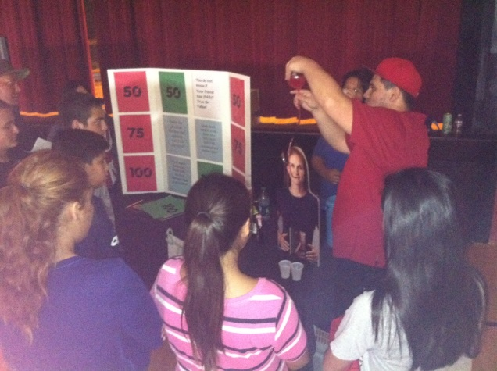
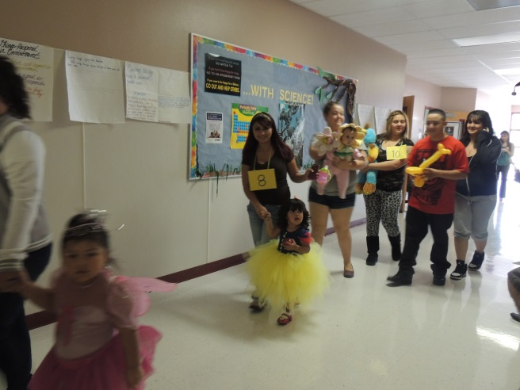
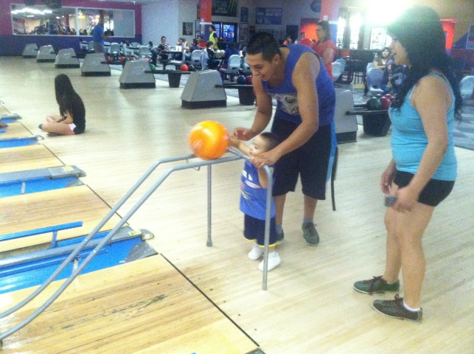
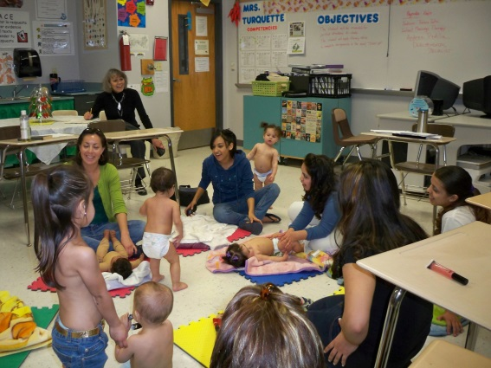
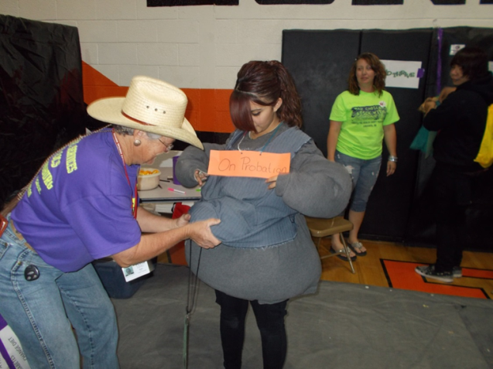
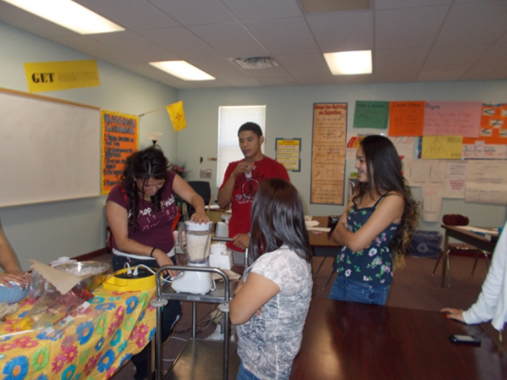
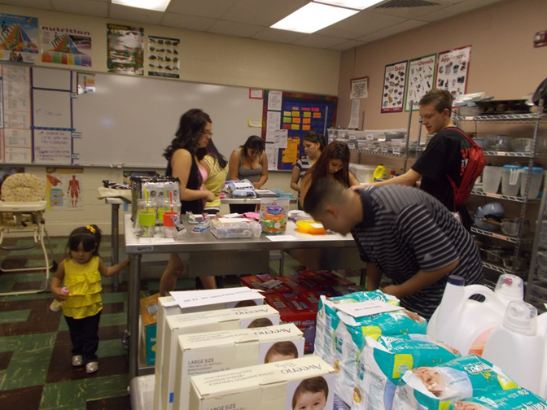
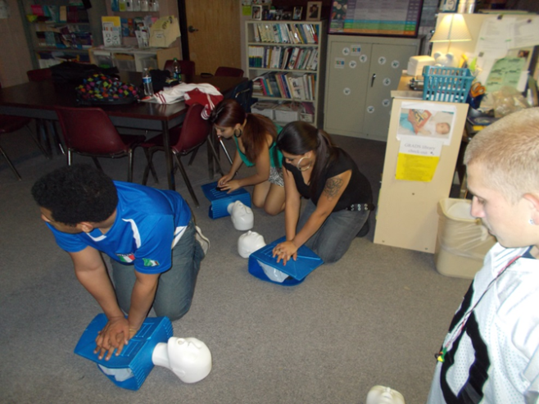
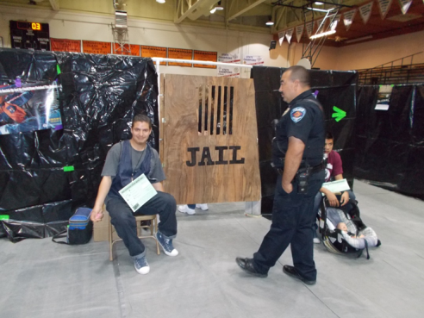
How To Encourage Creativity
Incorporate activities into your curriculum for the year which are aligned with your units

Slide 6
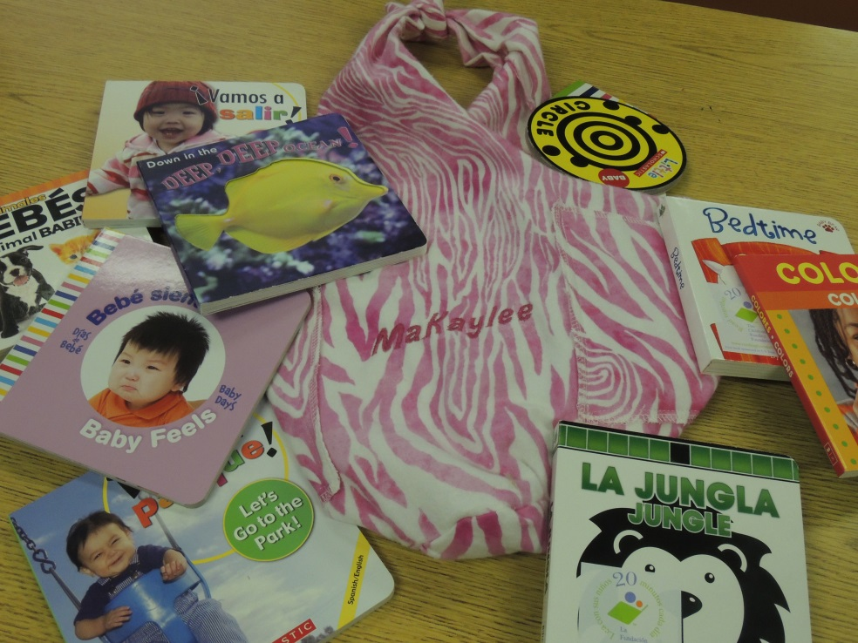
How to Encourage Creativity
Design Meaningful Projects!
Encourage student generated ideas but can also be teacher generated

Slide 7
How to Manage time to utilize notebooks & grading!

Slide 8
Some Tips
Cooperative work is ideal to incorporate into your GRADS class. Allow returning GRADS students to become peer mentors for new students. Really encourages a strong bond among your students which then drives your class
Include in your syllabus your weights for everything you assign : ex. Quiz 10%, projects 20% participation 30%
Student Notebooks can be kept in a binder, hanging folder crate or E- Portfolio (uses digital archive documents)
Student add work to their notebook as they work in a unit of study.
Weekly, monthly or at end of unit, have students do a reflection of work checking off what was covered on GRADS competency page for the unit
(great way to review for end of unit exam or quiz)

Slide 9
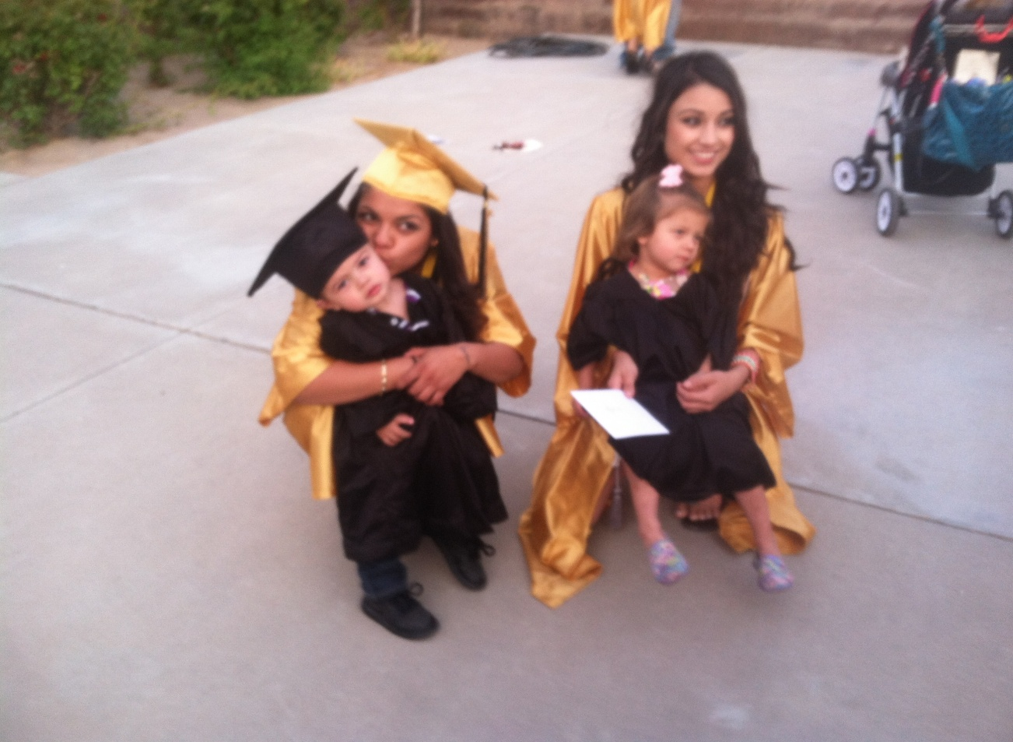
OUR ULTIMATE OBJECTIVE: To equip our GRADS students with “Dual Role Skills” upon Graduation.
*Dual Role Skills: Resources, tools, and the knowledge necessary to become a successful student AND parent!

